Slide 1

Opioid Dataset Patterns Analysis
Summary of Findings from Exploratory Data Analysis

Slide 2
The Goals:
Objective: To analyze patterns in opioid prescriptions through exploring patient age, dosage levels, and duration of medication use.
Approach: Conducted Exploratory Data Analysis (EDA) using Python in Google Colab.
Data Source: Dataset includes patient age, total opioid dosage, and medication duration.

Slide 3
Dataset overview
Groups & Demographics: The experiment includes two groups, subjects divided into gender data - 0 or 1, and age.
BMI & Opioid Use: BMI for each subject is noted, with some entries in the data missing, along with dosages of fentanyl, alfentanil, and midazolam.
Sensory & Motor Onset: Times of onset for sensory and motor are measured, which are the first sensory reaction and nerve block response.
Medication and Pain Duration: Data are given on the duration of medication effects, including censored indicators and total opioid use recorded.
Pain Scores: VPS (Verbal Pain Score) ratings at rest and with movement gauge the pain experience across different conditions.

Slide 4
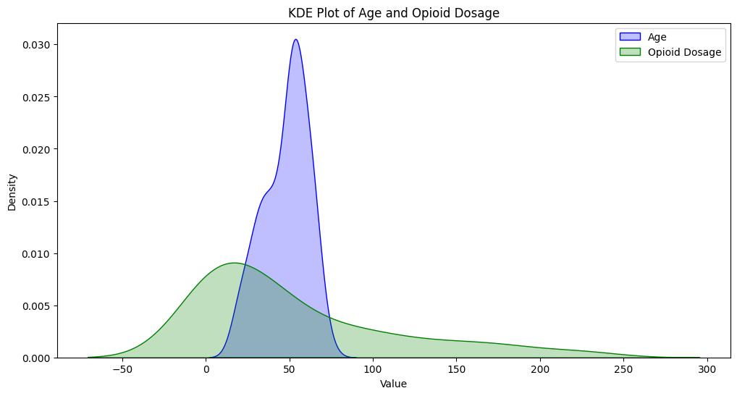

Slide 5
Key Findings:
Younger age groups tend to have shorter medication durations.
Higher opioid dosages generally relate to longer treatment times.
A broad range of dosages prescribed across all ages, indicating varied treatment needs.
Most tend to fall within the age range of 45-65 with lower doses than the younger population

Slide 6
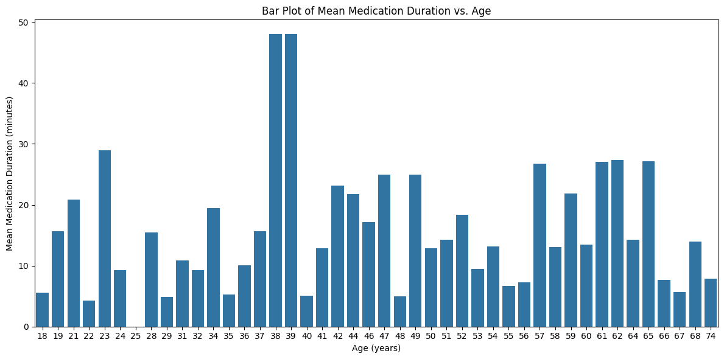

Slide 7
Key Findings:
Young Adults 18-30: The average of medication duration is relatively low for most, with the average for 18-year-olds being about 5.58 minutes, peaking at 28 years with an average of 15.47 minutes, dramatically falling to 0 for 25 years.
Middle Age 31-50: A higher variable average is present; there is one noticeable peak for 38 and 39, both averaging 48 minutes. Possible evidence of higher opioid use or need for longer treatment.
Older Adults: Medication duration tends to increase with age; the oldest participants 61&62 averaged about 27 minutes

Slide 8
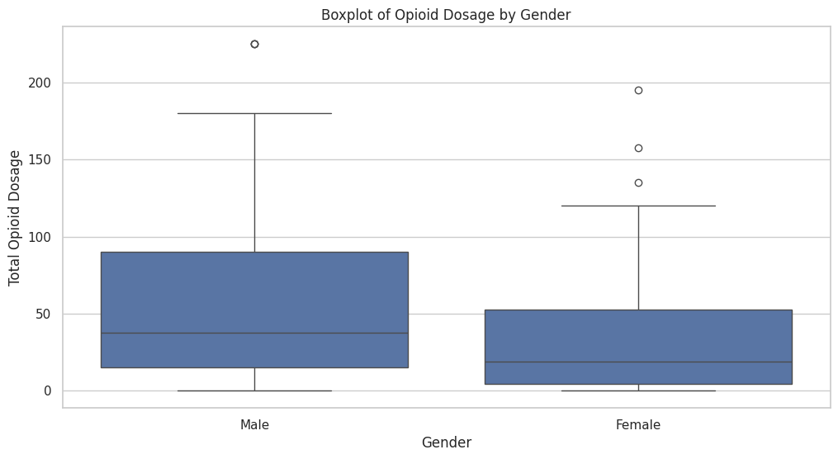

Slide 9
Key Findings
Overview:
The bar plot depicts the age of patients and the average duration of medication, enabling one to understand how the treatment duration varies for different age groups.
Observations:
Young Adults 18-30: The average of medication duration is relatively low for most, with the average for 18-year-olds being about 5.58 minutes, peaking at 28 years with an average of 15.47 minutes, dramatically falling to 0 for 25 years.
Middle Age 31-50: This age group gives a more variable average; there is one noticeable peak for age 38 and another for 39, both averaging 48 minutes - perhaps evidence of higher opioid use or need for longer treatment.
Older Adults: The time taken for medication is variable but with a general tendency to increase with age; the oldest participants, 61 and 62, averaged about 27 minutes each day, suggesting continued treatment in this population.

Slide 10
Summary of Findings: These findings provide a proof that there is significant age-related variation in medication duration and are the basis of exploratory data analysis in opioid-treated patients. In summary, the bar plot illustrates the tendency of older age groups to have longer mean medication duration, while the box plot also depicts more variability of the length of the treatments across different ages.
Clinical Relevance: Knowledge of such trends will help doctors in further streamlining their opioid prescribing practices. In this light, treatment plans can be individualized based on a person's age with the intention of reducing chances of dependency and adverse side effects during continued use of opioids.
Future studies will be required to determine the underlying factors for these variations, such as comorbidities, specific conditions treated, and demographics. Duration of medication effects is another line of study regarding patient outcomes.

Slide 11


